Slide 1
ECE213: Digital Electronics
UNIT-5
Sequential Logic Circuit Applications
1

Slide 2
Introduction: Registers
An n-bit register has a group of n flip-flops and some logic gates and is capable of storing n bits of information.
The flip-flops store the information while the gates control when and how new information is transferred into the register.
Some functions of register:
retrieve data from register
store/load new data into register (serial or parallel)
shift the data within register (left or right)

Slide 3

Introduction – Shift Register
Shift registers are constructed using several flip- flop, connected in such a way to STORE and TRANSFER/ Shift digital data.
Basically, D flip-flop is used. The input data (either ‘0’ or ‘1’) is applied to the D terminal and the data will be stored at Q during positive/negative-edge transition of the clock
pulse.
D Q
Q
4

Slide 4
QUIZ
The register is a type of ___________ a) Sequential circuit b) Combinational circuit c) CPU d) Latches

Slide 5
Shift Register
One D FF is used to store 1-bit of data. Thus, the number of flip-flops used is the same with the number of bit stored.
Shift register mean that the data in each FF can be transferred/move to other FF upon edge triggering of the clock signal.
Four types of data movement in shift register are:-
Parallel In/Parallel Out (PIPO)
Serial In/ Serial Out (SISO)
Parallel In/ Serial Out (PISO)
Serial In/ Parallel Out (SIPO)
5

Slide 6
Shift Registers
Basic data movement in shift registers (four bits are used for illustration).
Data in
Data out
Data out
Data in
(a) Serial in/shift right/serial out
(b) Serial in/shift left/serial out
Data in
Data in
Data in
Data out
Data out
(c) Parallel in/serial out
(d) Serial in/parallel out
Data out
(e) Parallel in / parallel out
(f) Rotate right
(g) Rotate left

Slide 7

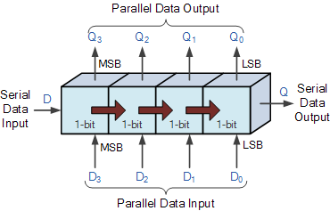
Seiral Data Versus Parallel Data movement
Serial | Parallel
Movement of N-bit data require N number of CLK pulses. Thus, the operation is slow. | Require only one CLK pulse to transfer all N-bit of data. Thus, operation is faster than serial.
Only one FF is required to be connected at the output terminal, thus only one wire is required. | Required N number of connection to the output terminal, which is proportional to the number of bit. Thus, too many connection is required.
6

Slide 8
QUIZ
The main difference between a register and a counter is ___________ a) A register has no specific sequence of states b) A counter has no specific sequence of states c) A register has capability to store one bit of information but counter has n-bit d) A register counts data

Slide 9

Flip-flop configuration for PIPO register.
D₃ D₂ D₁
D₀
D Q₃
D Q₂
D Q₁
D Q₀
CP
CP
CP
CP
CLK
Q₃
Q₂
Q₁
Q₀
7

Slide 10
PIPO data movement.
CLK
D₃
1
0
1
1
1
D₂
0
1
0
1
0
D₁
1
1
1
0
1
D₀
0
0
0
1
0
Q₃
0
1
0
Q₂
0
0
1
0
Q₁
1
1
Q₀
0
0
0
8

Slide 11

Flip-flop connection for SISO.
1st CLK
2nd CLK
3rd CLK
4th CLK
^{D}IN
D Q₀
CP
D Q₁
CP
D Q₂
CP
D Q₃
CP
CLK
FF0
FF1
FF2
FF3
EE 202 : DIGITAL ELECTRONICS
9

Slide 12
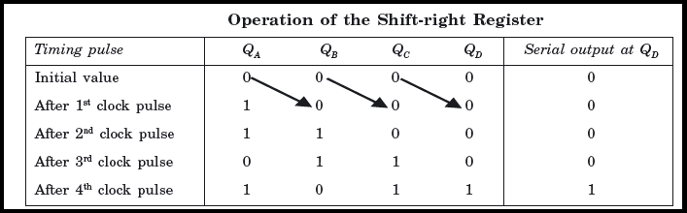
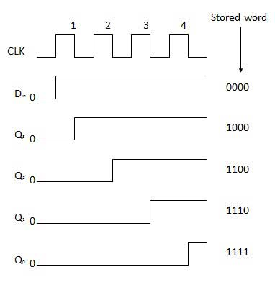

Slide 13
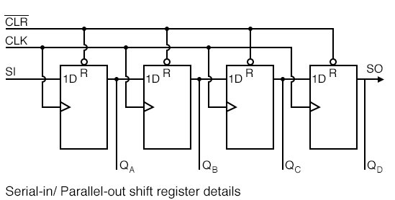
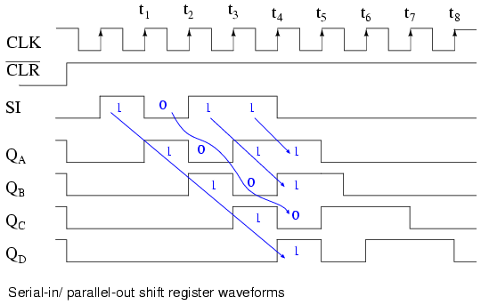
Serial In/Parallel Out (SIPO)

Slide 14

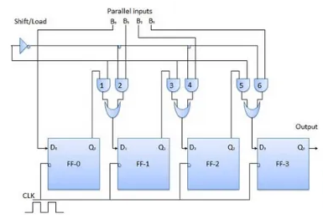

Slide 15
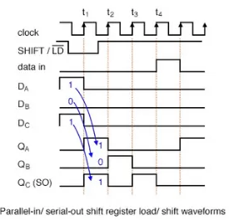
PISO data movement.

Slide 16

Flip-flop connection for PISO
SHIFT/LOAD^{D0}
D₁ D₂
D₃
Serial data out
D Q₀
CP
D Q₁
CP
D Q₂
CP
D Q₃
CP
CLK
FF0
FF1
FF2
FF3

Slide 17
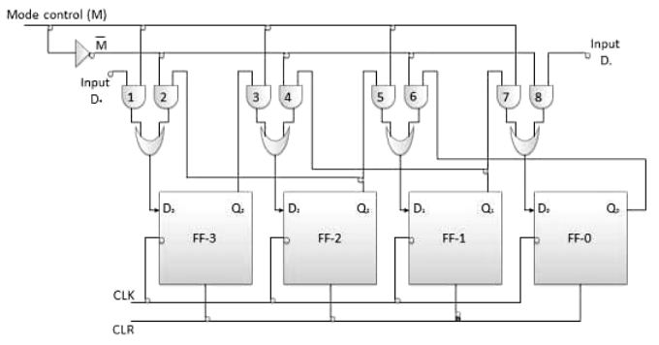
Bidirectional Shift Registers
Data can be shifted either left or right, using a control line RIGHT/LEFT (or simply RIGHT) to indicate the direction.

Slide 18
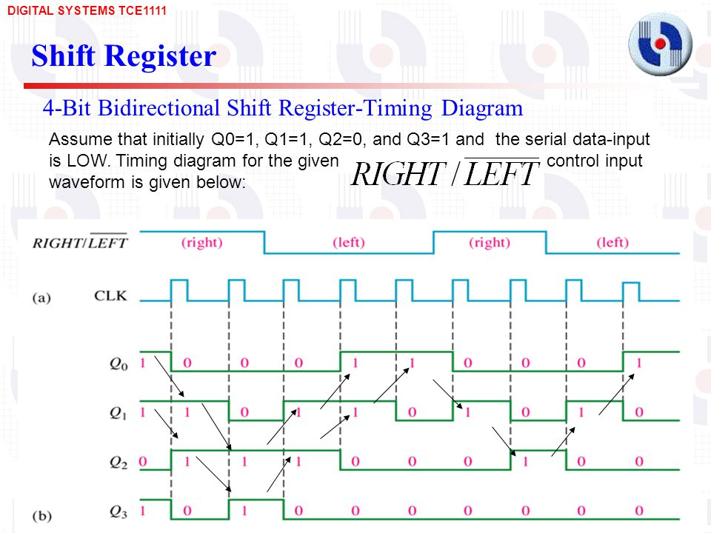

Slide 19
Bidirectional Shift Registers
4-bit bidirectional shift register with parallel load.

Slide 20
Bidirectional Shift Registers
4-bit bidirectional shift register with parallel load.
Parallel outputs
A₄
A₃
A₂
A₁
Clear
Q
Q
Q
Q
D
D
D
D
CLK
s₁
4x1 MUX
4x1 MUX
4x1 MUX
4x1 MUX
s₀
3 2 1 0
3 2 1 0
3 2 1 0
3 2 1 0
Serial input for shift-right
Serial input for shift-left
I₄
I₃
I₂
I₁
Parallel inputs

Slide 21
Basic connections
The first input (zeroth pin of multiplexer) is connected to the output pin of the corresponding flip-flop.
The second input (first pin of multiplexer) is connected to the output of the very-previous flip flop which facilitates the right shift.
The third input (second pin of multiplexer) is connected to the output of the very-next flip-flop which facilitates the left shift.
The fourth input (third pin of multiplexer) is connected to the individual bits of the input data which facilitates parallel loading.

Slide 22
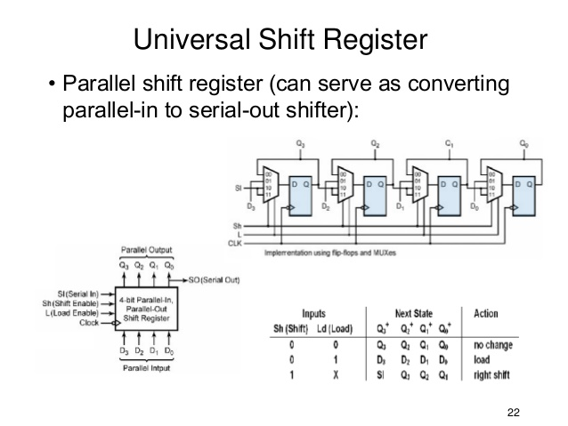

Slide 23
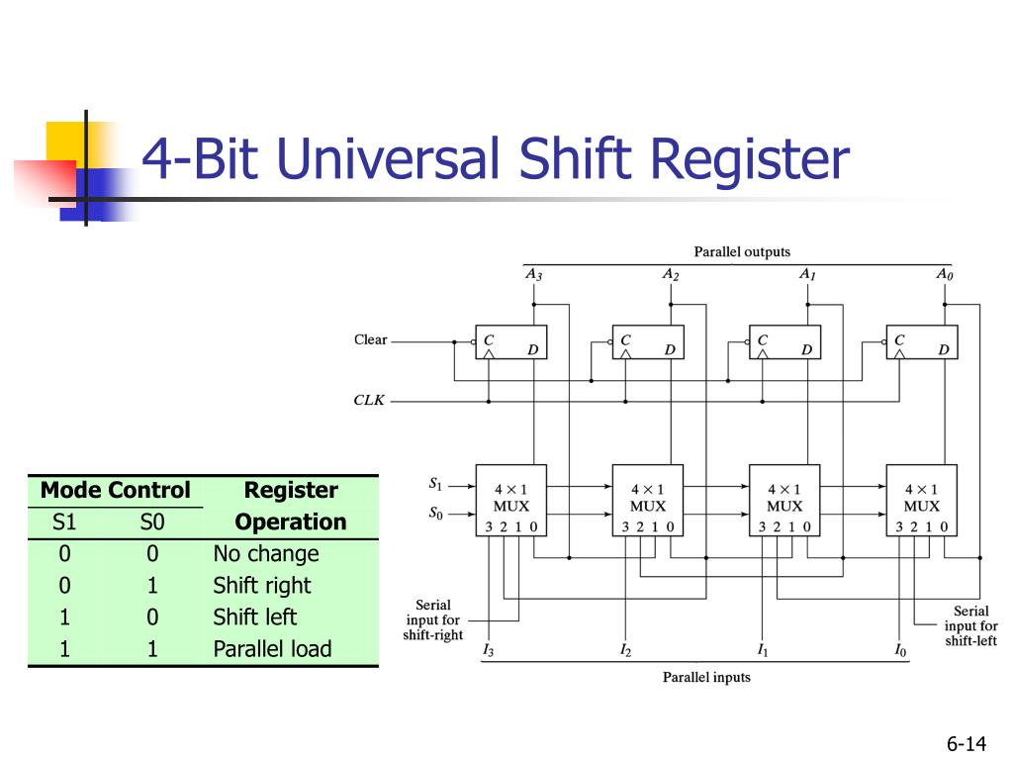
Universal Shift Register

Slide 24
QUIZ
In serial shifting method, data shifting occurs ____________
a) One bit at a time b) simultaneously c) Two bit at a time d) Four bit at a time

Slide 25
Integrated Circuits: Chips for shift registers
74164 is a 8-bit SIPO shift register
A B
74164
CLR CLK
Q₀ Q₁ Q₂ Q₃ Q₄ Q₅ Q₆ Q₇

Slide 26
Chips for shift registers
74165 is a 8-bit PISO register
D₀ D₁ D₂ D₃ D₄ D₅ D₆ D₇
SH/LD SER
74165
Q₇
CLK INH
CLK
Q₇

Slide 27
Chips for shift registers
74195 can be used as a 4-bit PIPO register
D₀ D₁ D₂ D₃
J
K
74195
SH/LD
CLR
CLK
Q₀ Q₁ Q₂ Q₃

Slide 28
Shift Register as arithmetic circuits:
Shift Register as Divider 2 circuits Example :
14 | = | 1 1 1 0
7 | = | 0 1 1 1
3.5= 3 | = | 00 1 1
1.5 = 1 | = | 0 0 0 1
Notes : Shift to RIGHT as divider 2.

Slide 29
Shift Register as arithmetic circuits:
Shift Register as Multiplier 2 circuits Example :
8 = 1100
16 = 10000
32 = 100000
64 = 1000000
Notes : Shift to LEFT as Multiplier 2.

Slide 30
Shift Register Counters
A shift register counter is a shift register Whose output being fed back (connected back) to the serial input. This shift register would count the state in a unique sequence!
Two types of shift register counter:-
The Ring Counter
The Johnson Counter

Slide 31
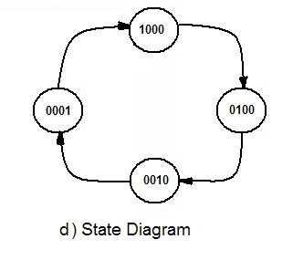
Ring Counter (continue)
Ring counters are used to construct “One-Hot” counters
It can be constructed for any desired MOD number
A MOD-N ring counter uses N flip-flops connected in the arrangement as shown in fig.
In general ring-counter will require more flip-flops than a binary counter for the same MOD number

Slide 32
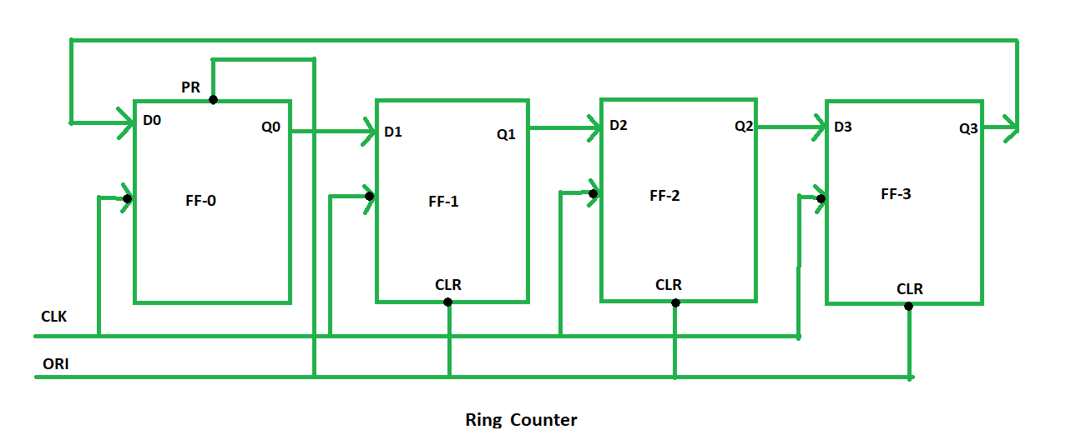
Ring Counter

Slide 33
Ring Counter (continue)

Slide 34
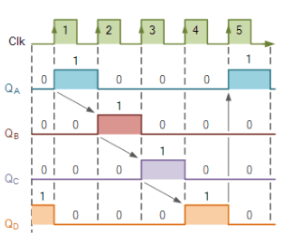
Ring Counter (continue)

Slide 35
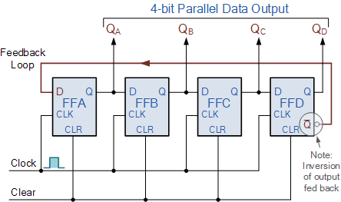
Johnson Counter
Or Twisted-ring counter
Johnson counter constructed exactly like a normal ring counter except that the inverted output of the last flip-flop is fed back to first flip-flop

Slide 36
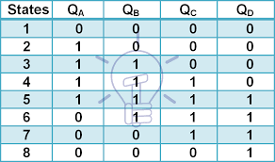
Johnson Counter

Slide 38
QUIZ
When the mode control pin is connected to ground, Universal Shift Register acts as _______
a. Unidirectional register b. Bidirectional register c. Multi-directional register d. None of the above

Slide 39
QUIZ
Ring shift and Johnson counters are ____________
a) Synchronous counters b) Asynchronous counters c) True binary counters d) Synchronous and true binary counters

Slide 40
Random Access Memory (RAM)
A memory unit stores binary information in groups of bits called words.
The data consists of n lines (for n-bit words). Data input lines provide the information to be stored (written) into the memory, while data output lines carry the information out (read) from the memory.
The address consists of k lines which specify which word (among the 2^{k} words available) to be selected for reading or writing.
The control lines Read and Write (usually combined into a single control line Read/Write) specifies the direction of transfer of the data.

Slide 41
Random Access Memory (RAM)
Block diagram of a memory unit:
n data input lines
n
k
Memory unit
2^{k} words
n bits per word
k address lines
Read/Write
n
n data output lines

Slide 42
Random Access Memory (RAM)
Content of a 1024 x 16-bit memory:
Memory address
binary
decimal
Memory content
0000000000
0000000001
0000000010
:
:
1111111101
1111111110
1111111111
0
1
2
:
:
1021
1022
1023
1011010111011101
1010000110000110
0010011101110001
:
:
1110010101010010
0011111010101110
1011000110010101

Slide 43
Random Access Memory (RAM)
The Write operation:
Transfers the address of the desired word to the address lines
Transfers the data bits (the word) to be stored in memory to the data input lines
Activates the Write control line (set Read/Write to 0)
The Read operation:
Transfers the address of the desired word to the address lines
Activates the Read control line (set Read/Write to 1)

Slide 44
Random Access Memory (RAM)
The Read/Write operation:
Two types of RAM: Static and dynamic.
Static RAMs use flip-flops as the memory cells.
Dynamic RAMs use capacitor charges to represent data. Though simpler in circuitry, they have to be constantly refreshed.

Slide 45
Random Access Memory (RAM)
A single memory cell of the static RAM has the following logic and block diagrams.
Select
Select
R
S
Input
Q
Output
Input
BC
Output
Read/Write
Read/Write
Logic diagram
Block diagram

Slide 46
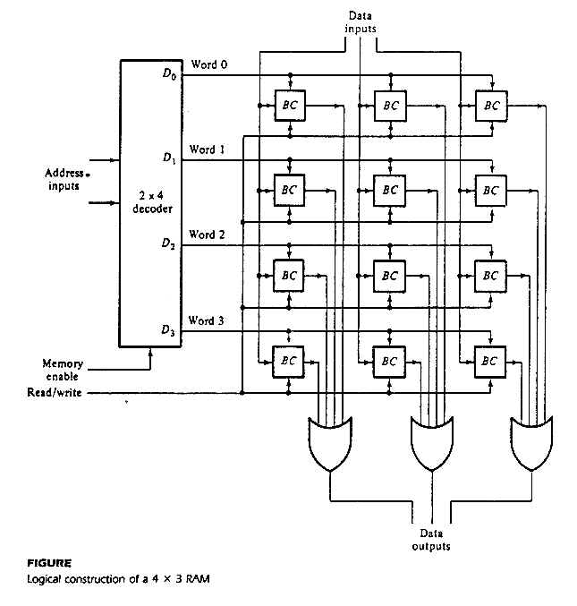
Random Access Memory (RAM)
Logic construction of a 4 x 3 RAM (with decoder and OR gates):

Slide 47
Random Access Memory (RAM)
An array of RAM chips: memory chips are combined to form larger memory.
A 1K x 8-bit RAM chip:
RAM 1K x 8
Input data
Address
Chip select
Read/write
8
DATA (8)
ADRS (10)
CS
RW
(8)
8
Output data
10
Block diagram of a 1K x 8 RAM chip

Slide 48
Random Access Memory (RAM)
Address
Input data
Lines
Lines
8 lines
11 10
0 – 9
0–1023
DATA (8)
ADRS (10)
CS
RW
(8)
2x4 decoder
1K x 8
S₀
S₁
0
1
2
3
1024 – 2047
DATA (8)
ADRS (10)
CS
RW
(8)
1K x 8
2048 – 3071
Read/write
DATA (8)
ADRS (10)
CS
RW
(8)
1K x 8
3072 – 4095
4K x 8 RAM.
DATA (8)
ADRS (10)
CS
RW
(8)
1K x 8
Output data

Slide 49
The End

